Slide 1
Visualization and Data Analysis of Automobile Dataset in R
SUBMITTED BY:
KOLLIPARA VENKATA NAGA HEMANTH (18BCE0538)
BOLISETTY SHRAVEN KUMAR (18BCE2413)
GEDDAM SITA RAMA SWAMY (18BCE0289)

Slide 2

About Us
Automobile Dataset
The Dataset consists of 5975 Rows and 14 Columns.
Categorical attributes are
Manufacturer
Location
Fuel Type
Transmission
Ownership
Integer attributes are
Year
Km Driven
Engine CC
Seats
Float attributes are
Power
Price

Slide 3
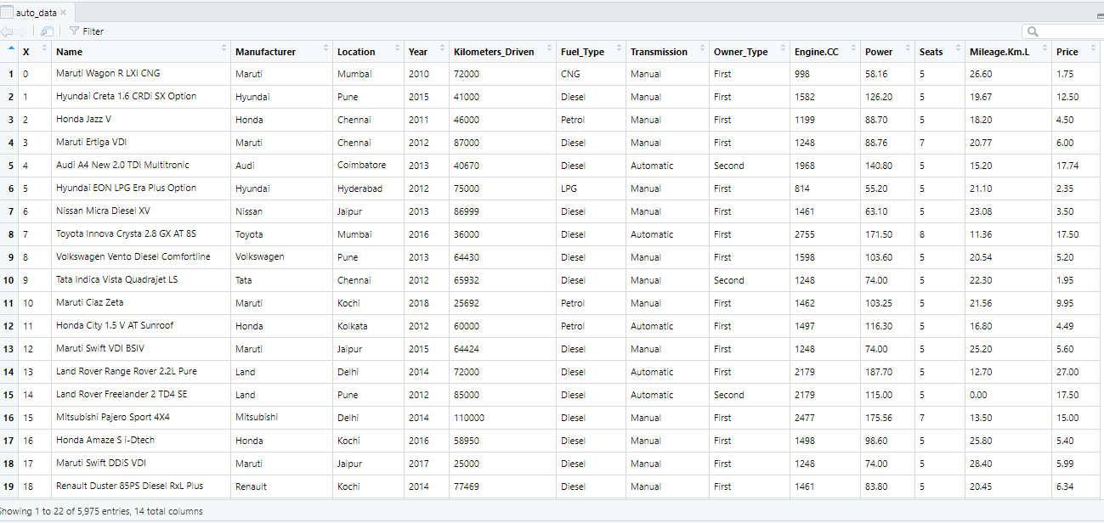
Automobile Dataset

Slide 4

Univariate Analysis

Slide 5
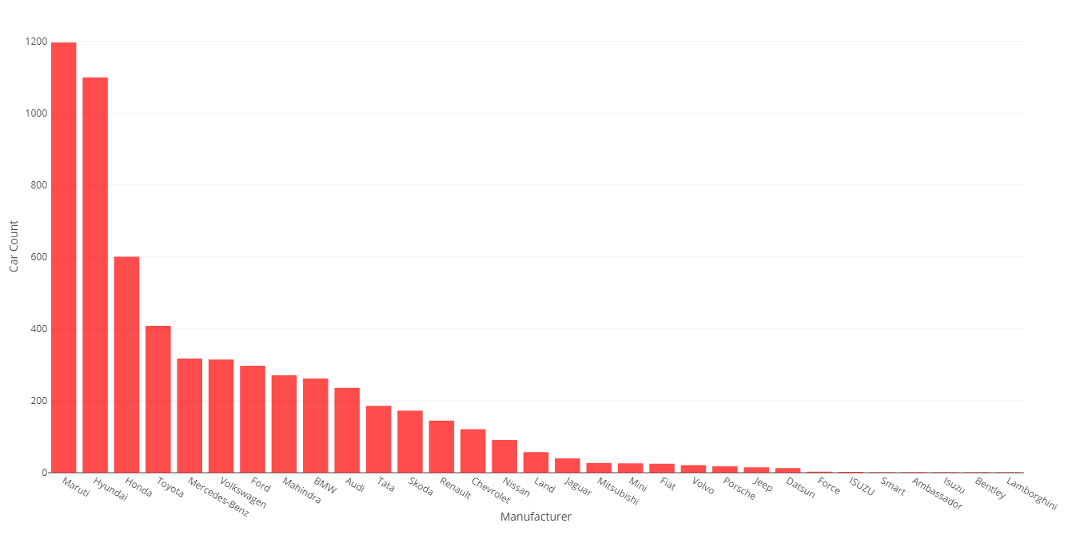
Distribution of Manufacturer

Slide 6
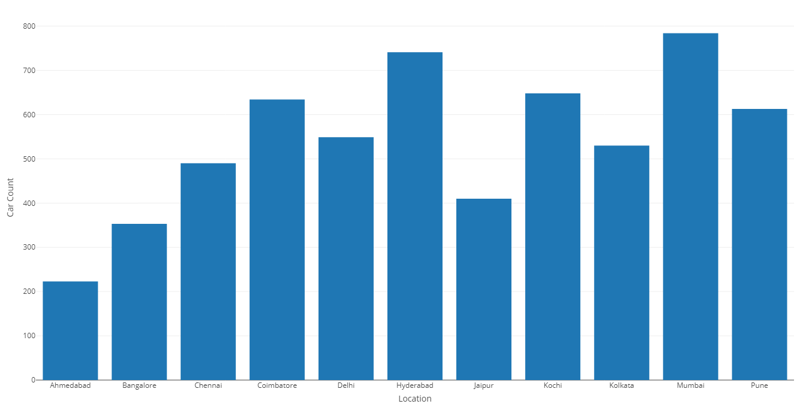
Distribution of Locations

Slide 7
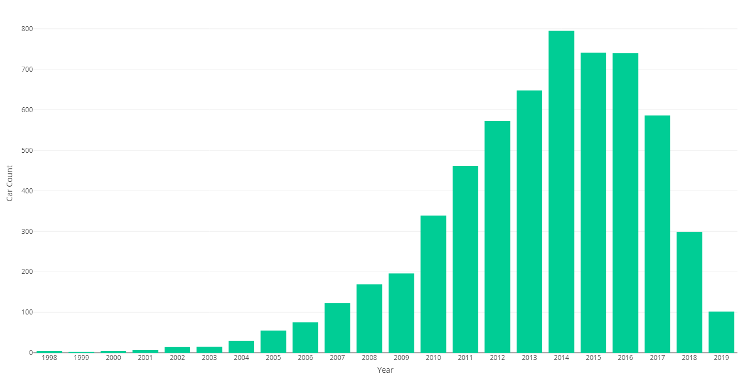
Distribution of Car Model Year

Slide 8
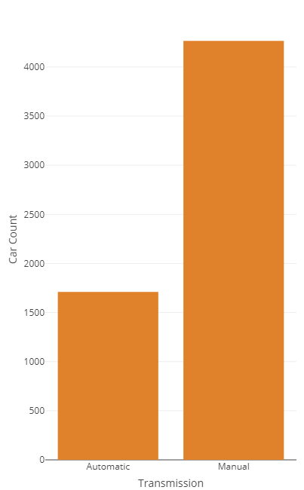
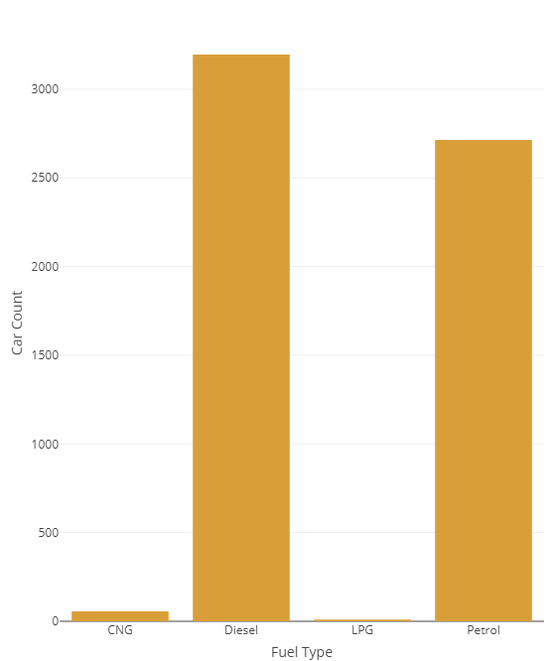
Distribution of Transmission Type & Fuel Type

Slide 9
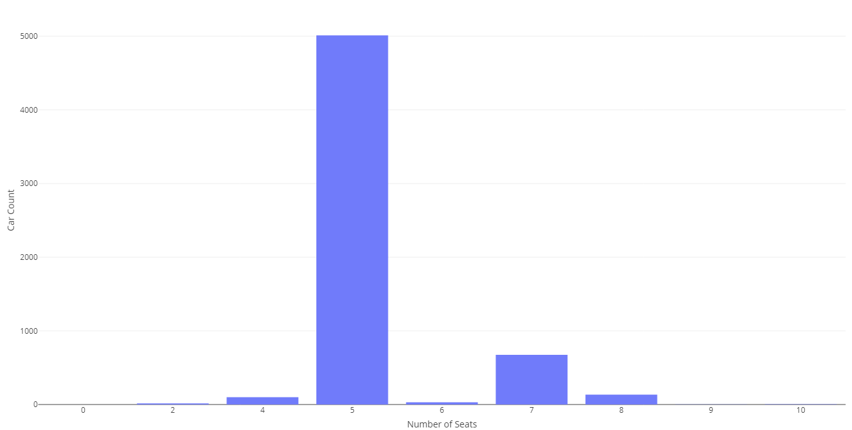
Distribution of Number of Seats

Slide 10
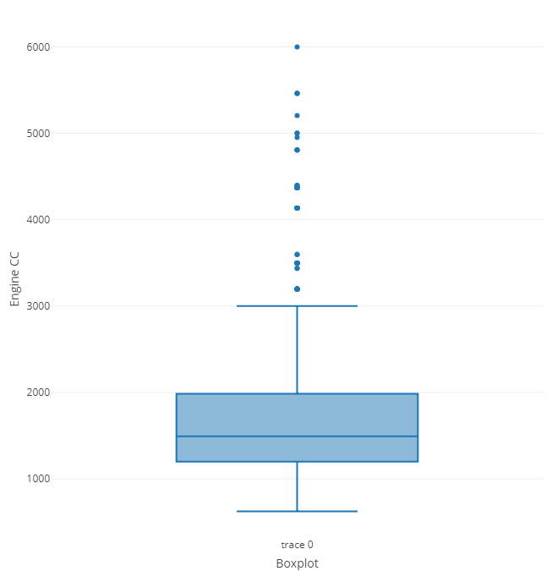
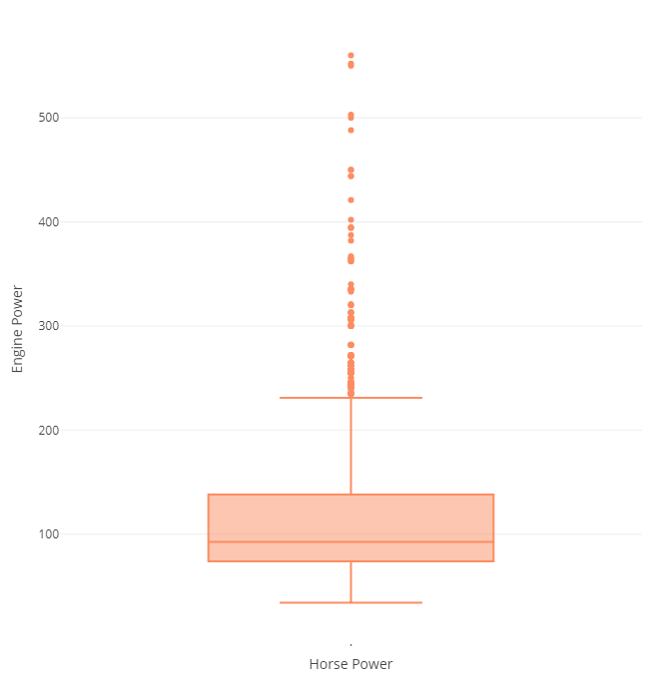
Boxplot of Engine Capacity & Power

Slide 11
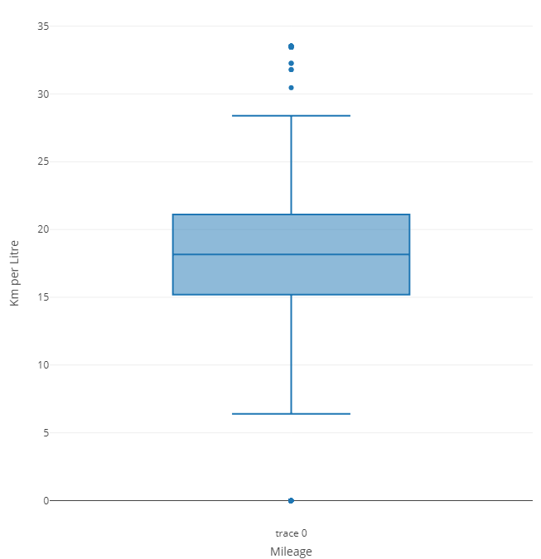
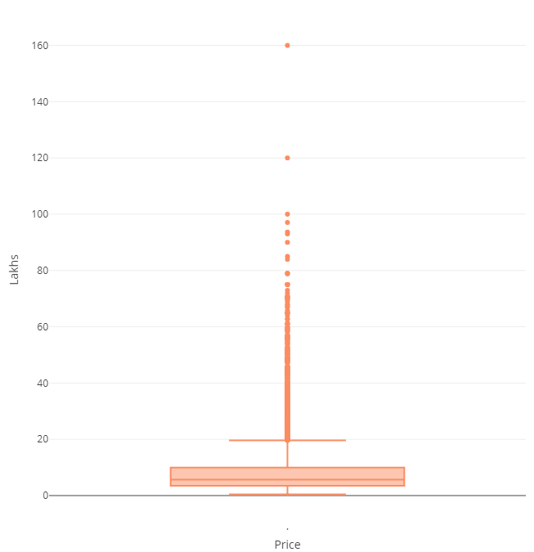
Boxplot of Engine Capacity & Power

Slide 12

Bivariate Analysis

Slide 13
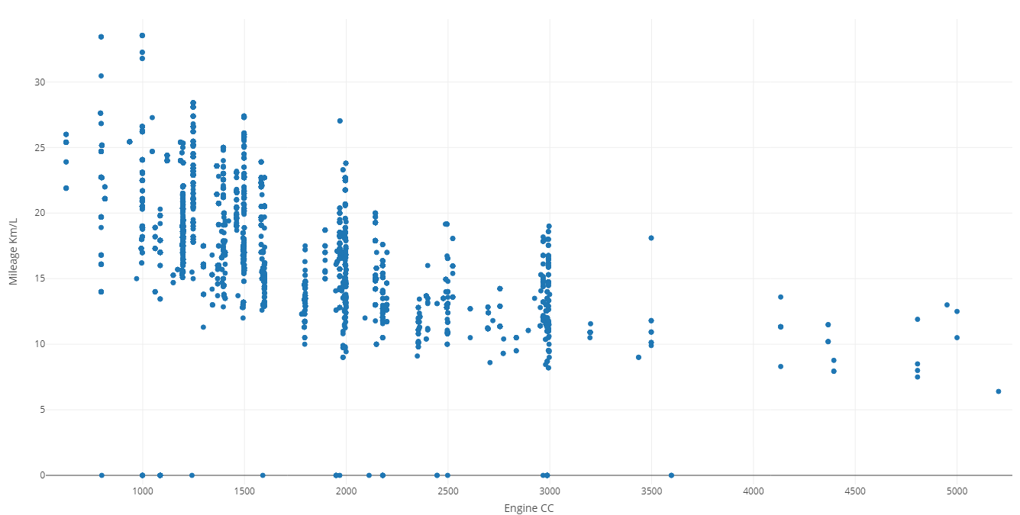
ScatterPlot of Mileage vs Engine Capacity

Slide 14
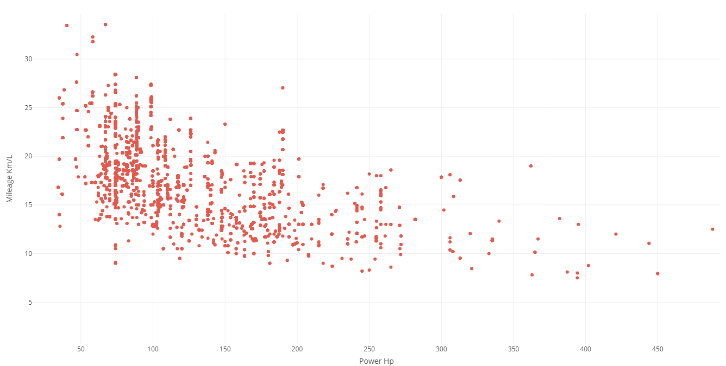
ScatterPlot of Mileage vs Power HP

Slide 15
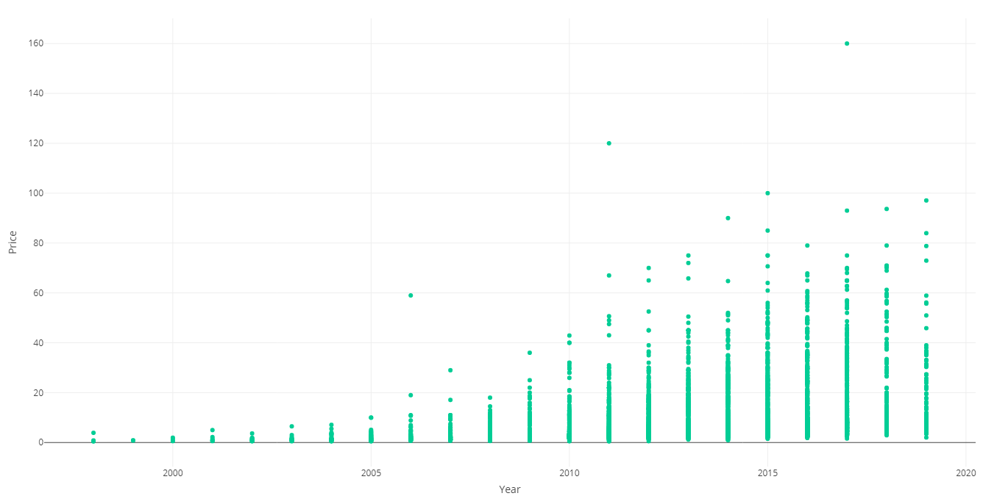
ScatterPlot of Price vs Model Year

Slide 16
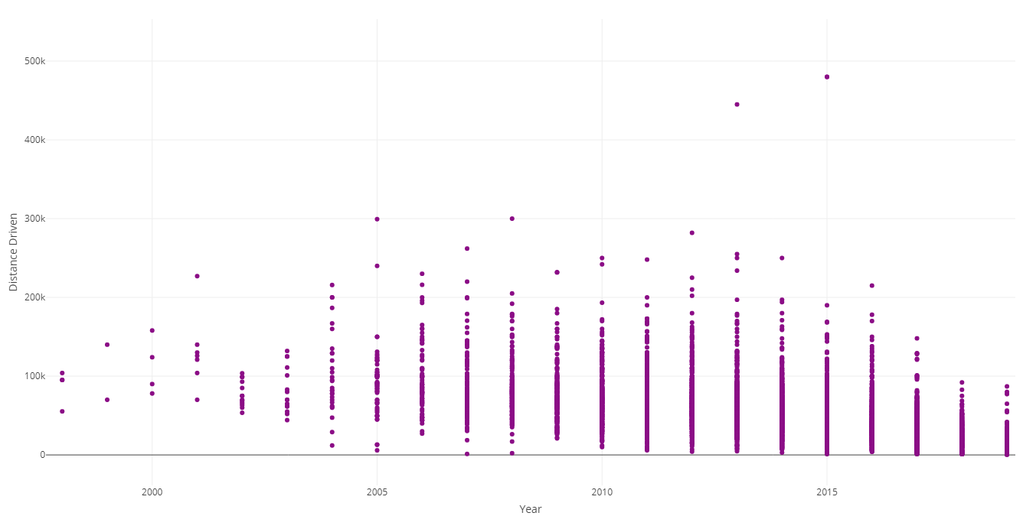
ScatterPlot of Distance driven vs Year

Slide 17
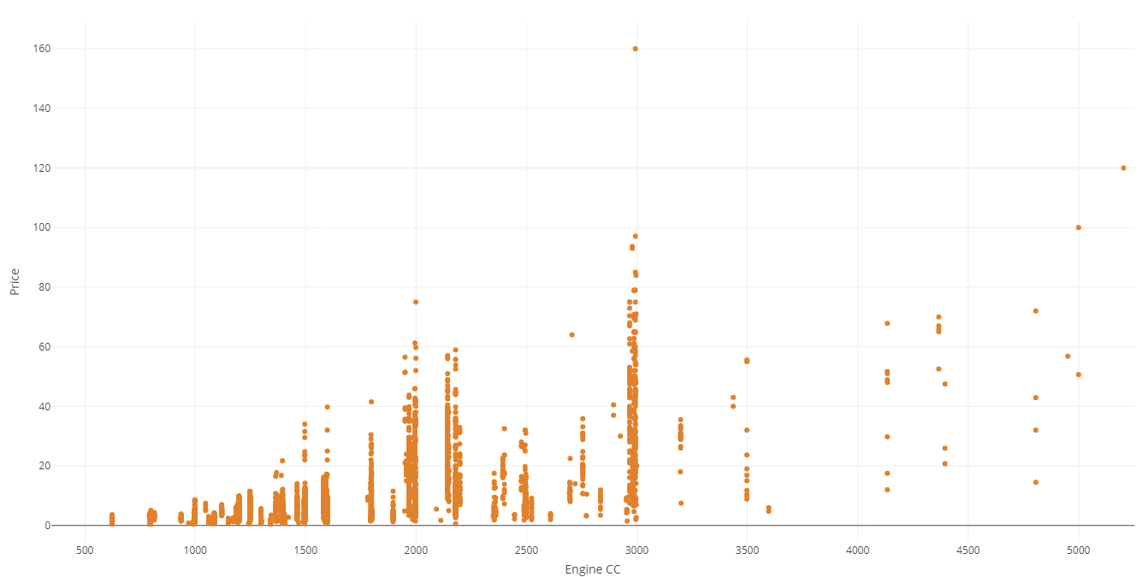
ScatterPlot of Price vs Engine capacity

Slide 18
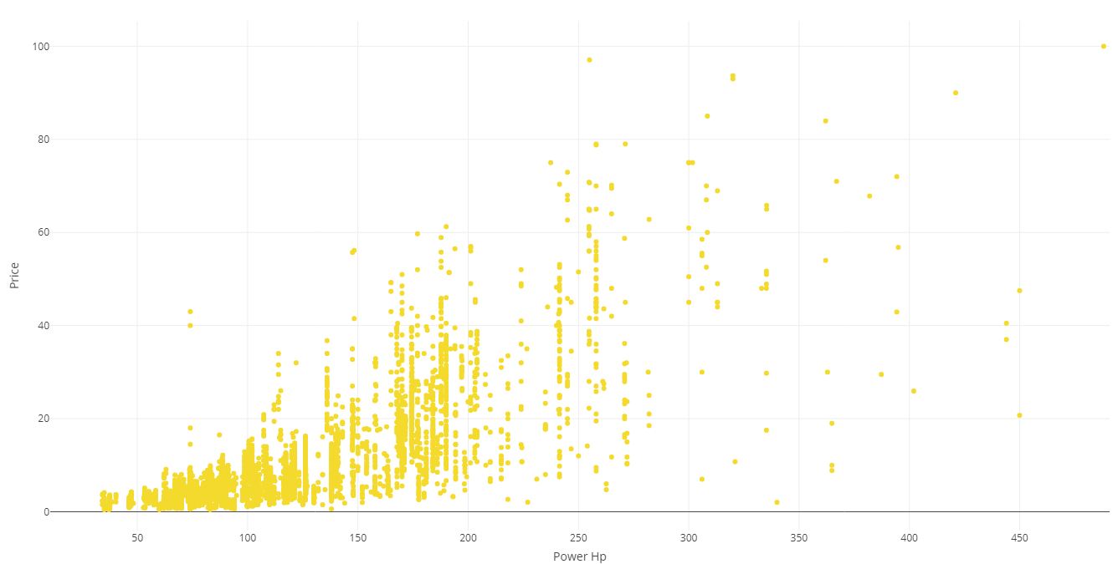
ScatterPlot of Mileage vs Power HP

Slide 19
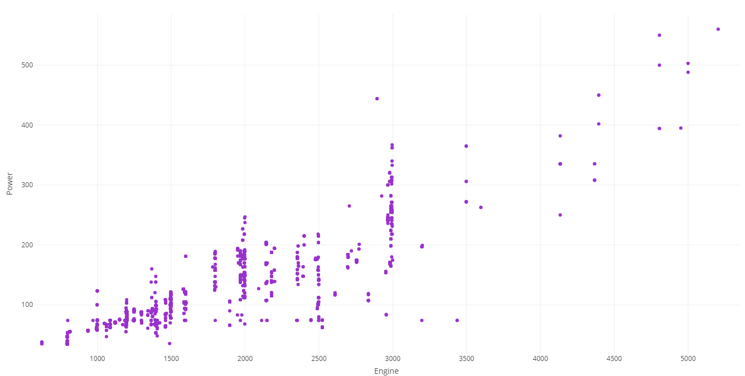
ScatterPlot of Power vs Engine capacity

Slide 20
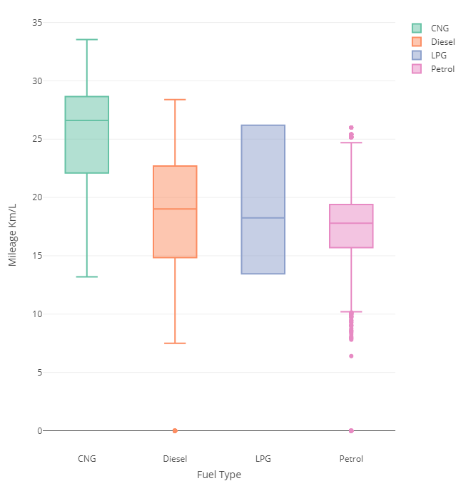
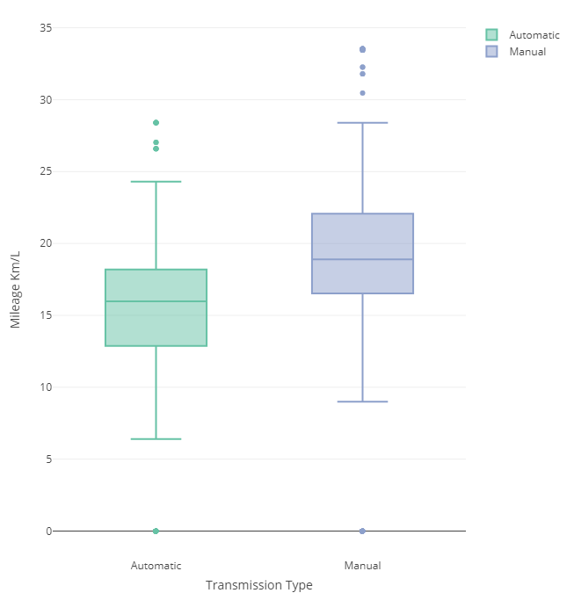
BoxPlot of Mileage vs Power HP & Transmission

Slide 21
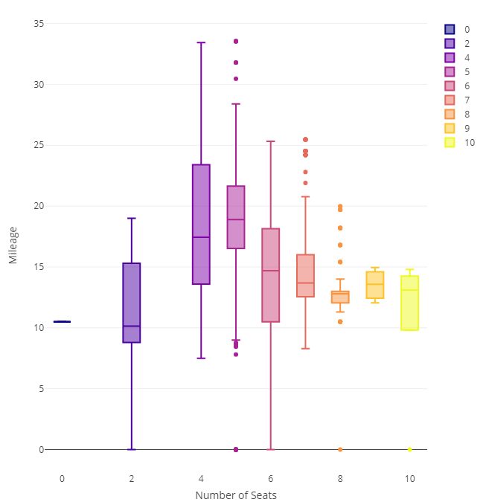
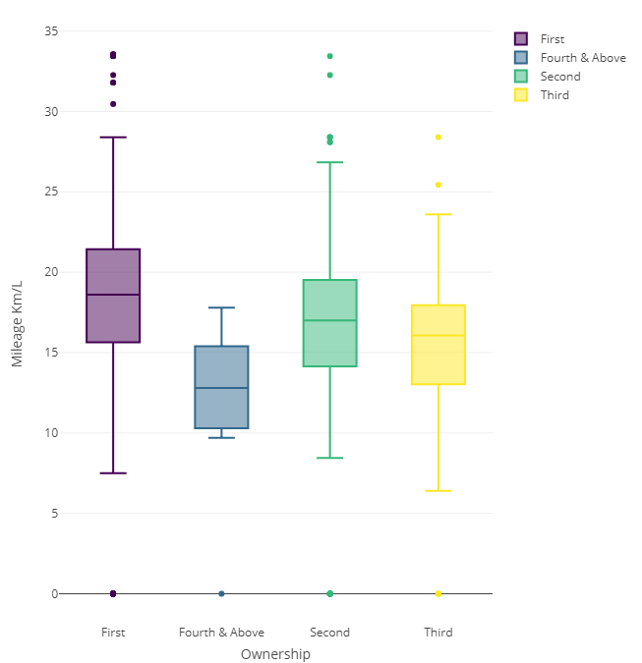
BoxPlot of Mileage vs Seats & Ownership

Slide 22
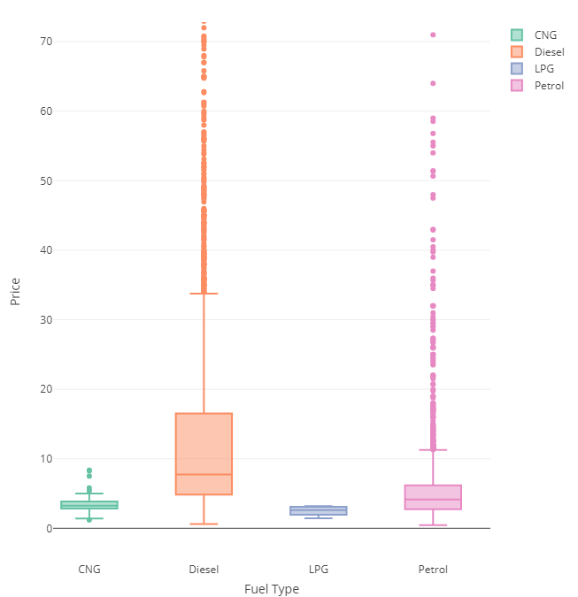
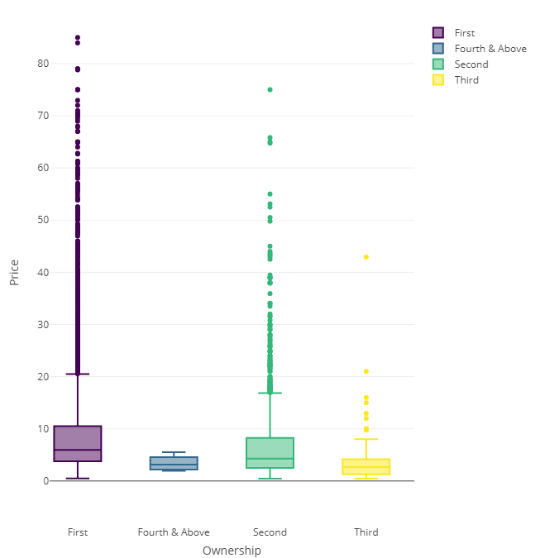
BoxPlot of Price vs Fuel & Ownership

Slide 23
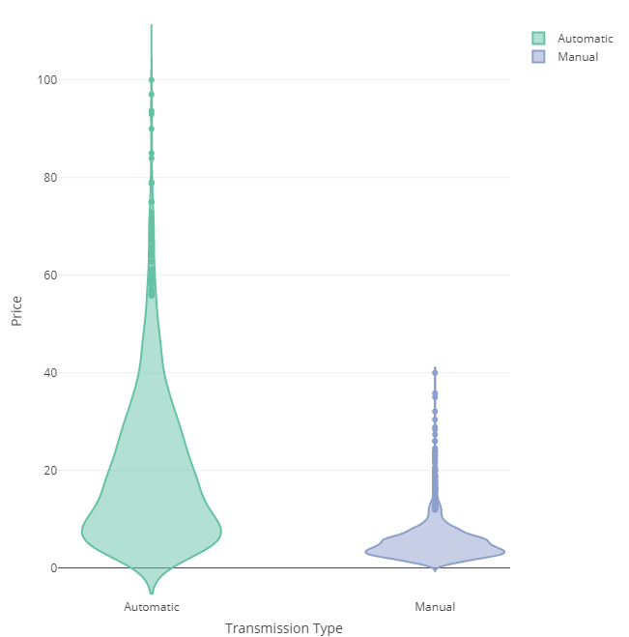
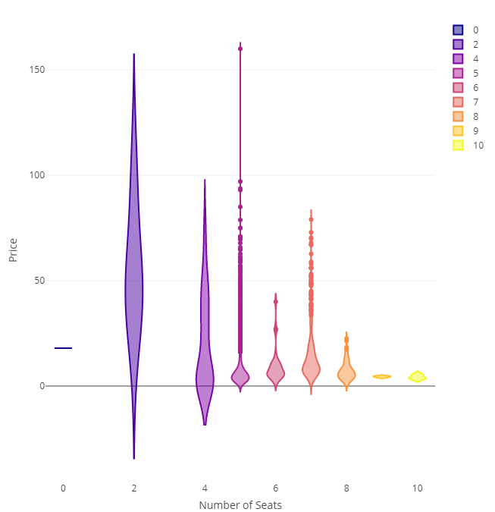
ViolinPlot of Price vs Transmission & Seats

Slide 24

Multivariate Analysis

Slide 25
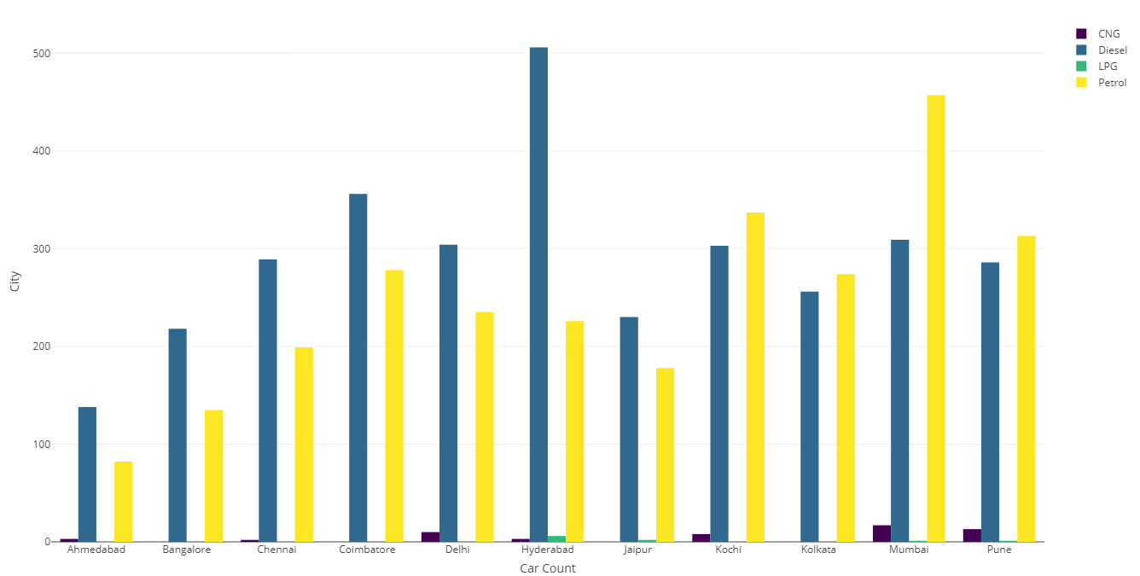
Distribution of Fuel type - Citywise

Slide 26
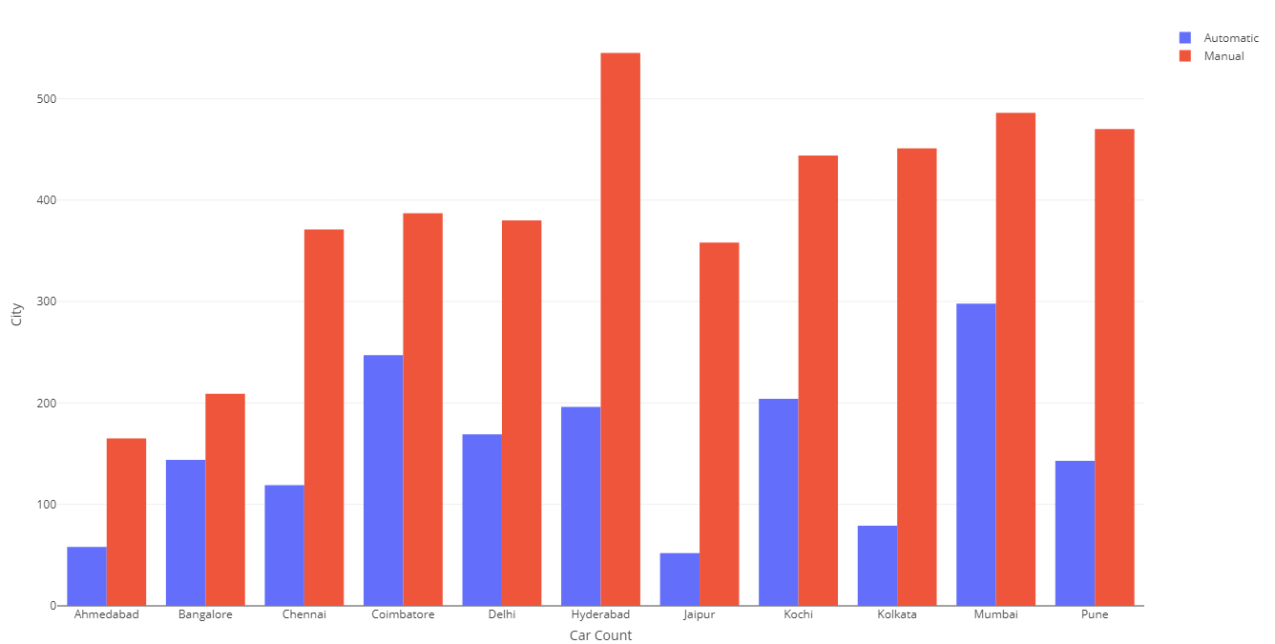
Distribution of Transmission- Citywise

Slide 27
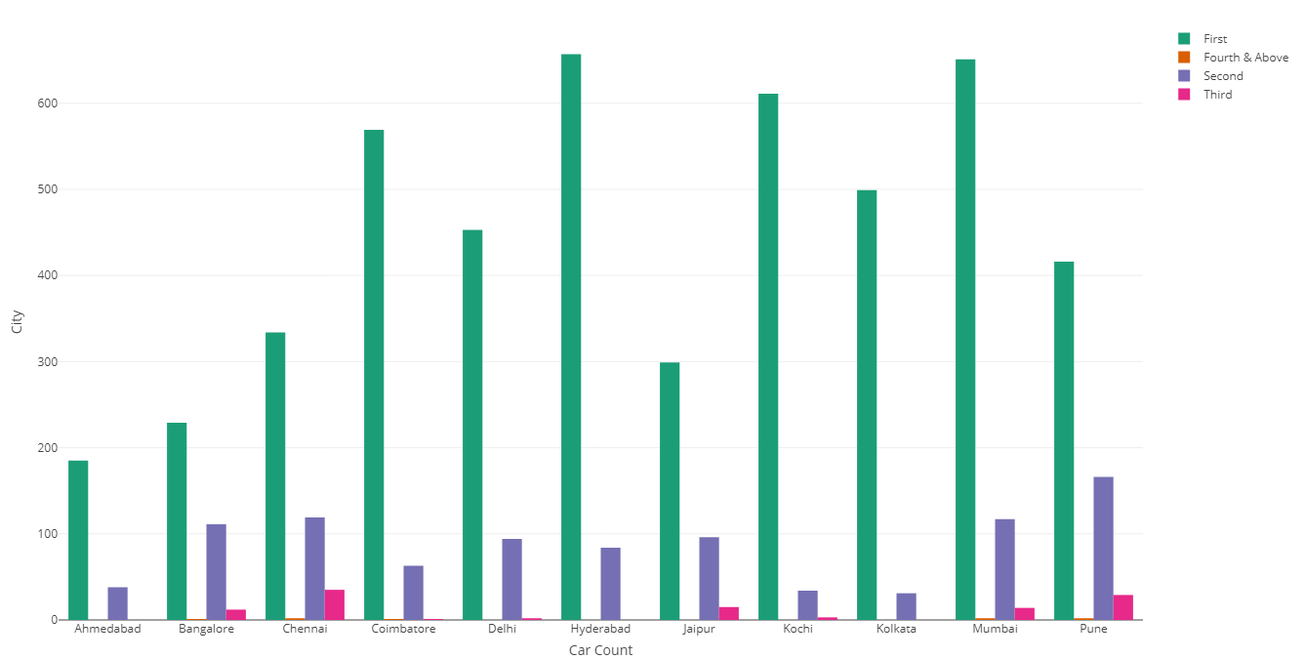
Distribution of Transmission- Citywise

Slide 28
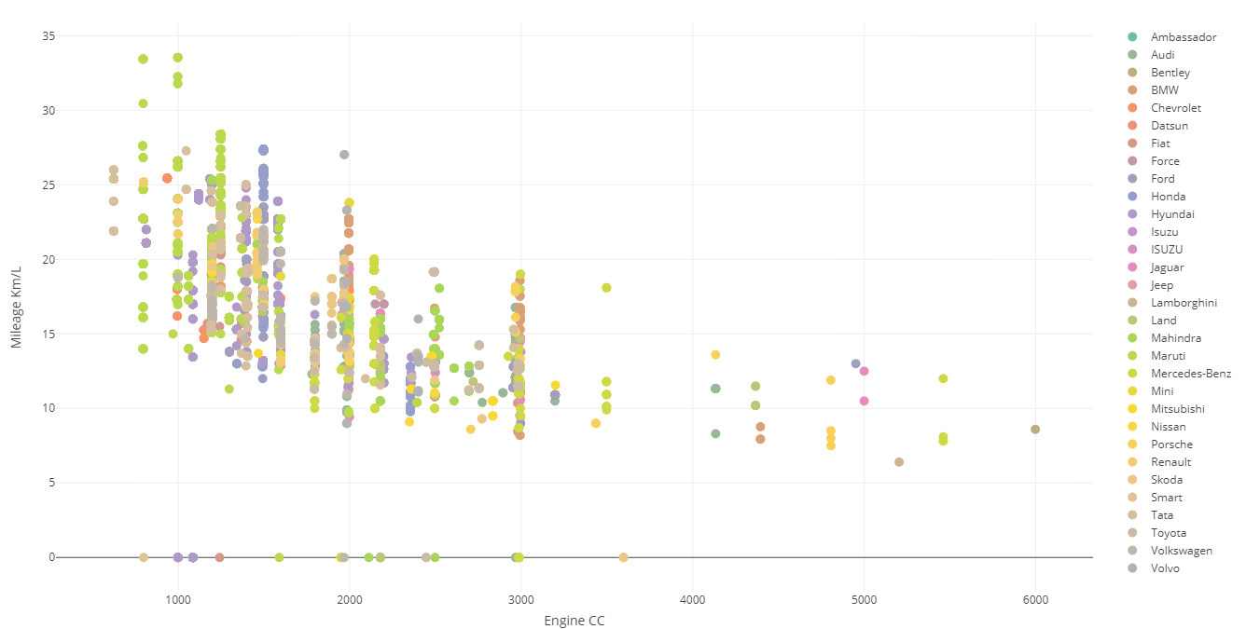
ScatterPlot of Mileage vs Engine Capacity vs Manufacturer

Slide 29
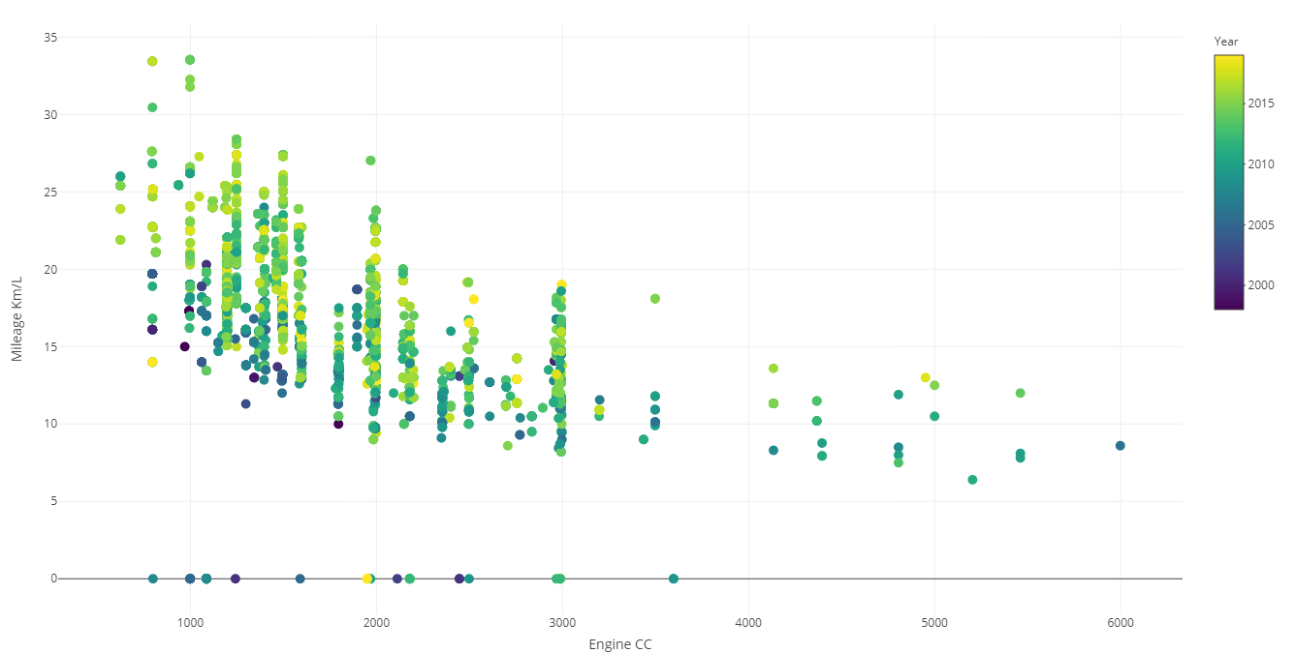
ScatterPlot of Mileage vs Engine capacity vs Model Year

Slide 30
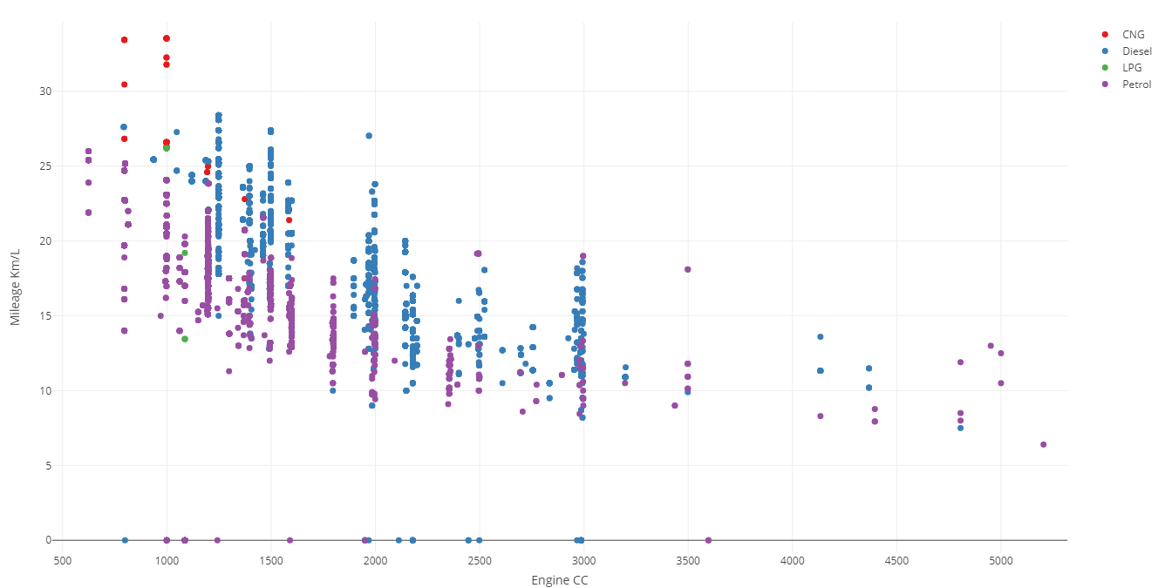
ScatterPlot of Mileage vs Engine capacity vs Fuel type

Slide 31
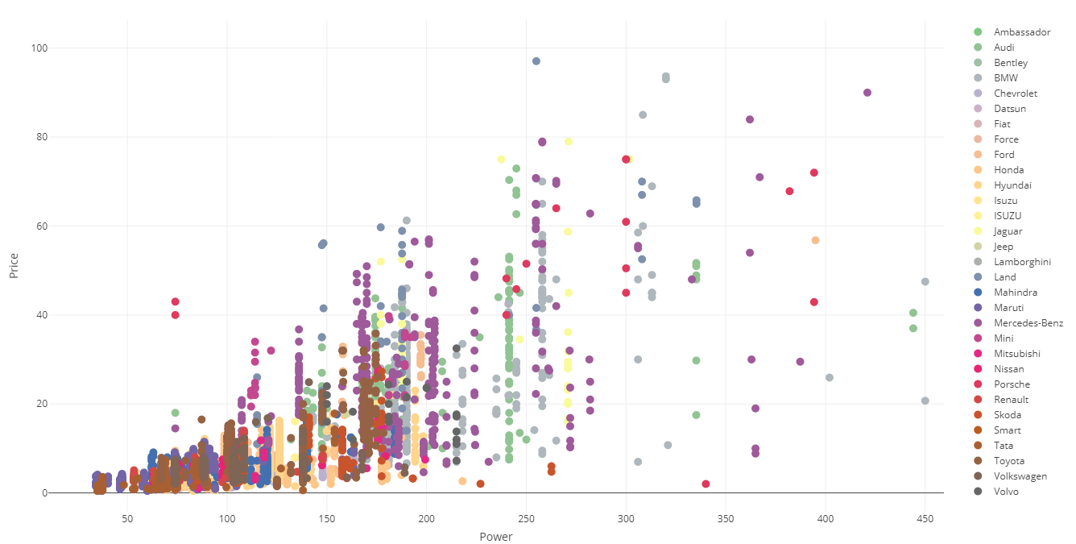
ScatterPlot of Price vs Power vs Manufacturer

Slide 32
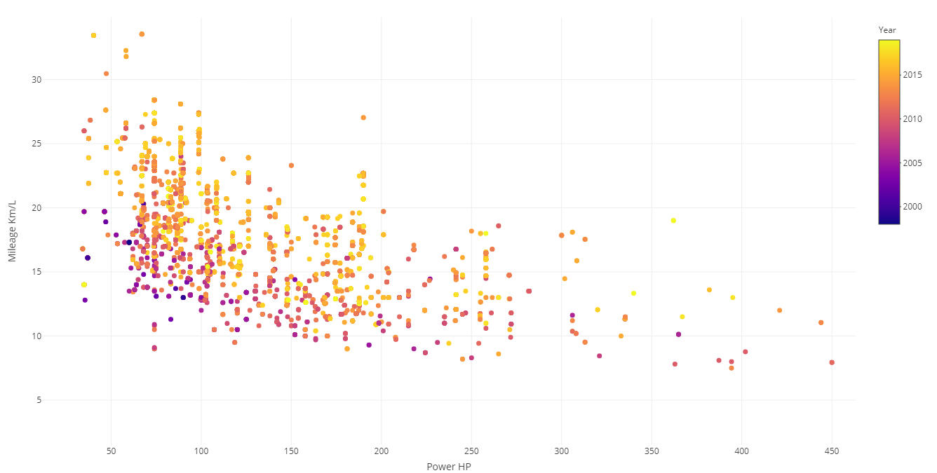
ScatterPlot of Mileage vs Power vs Model Year

Slide 33
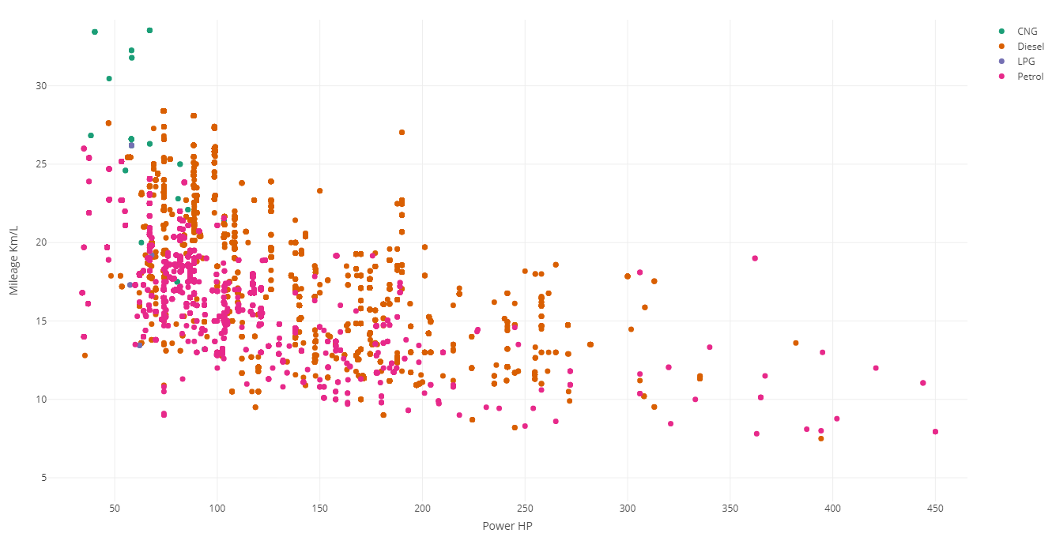
ScatterPlot of Mileage vs Power vs Fuel type

Slide 34
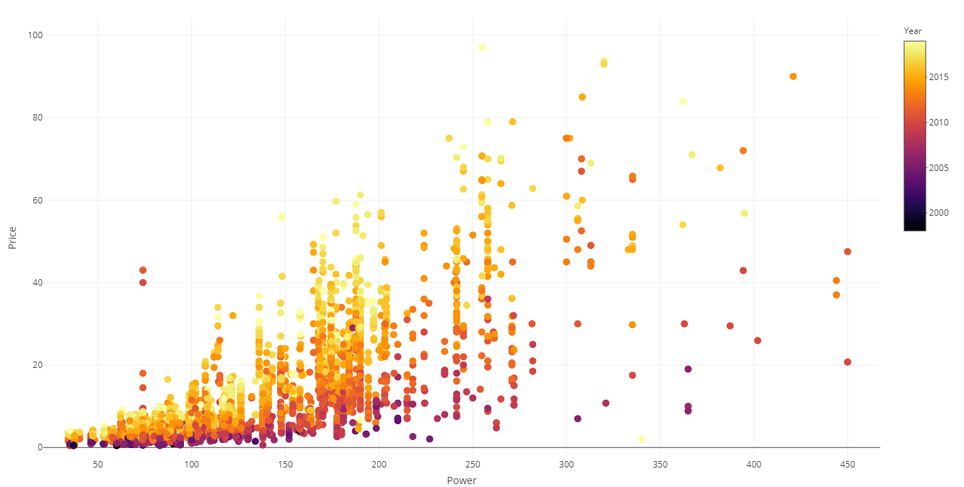
ScatterPlot of Price vs Power vs Model Year

Slide 35
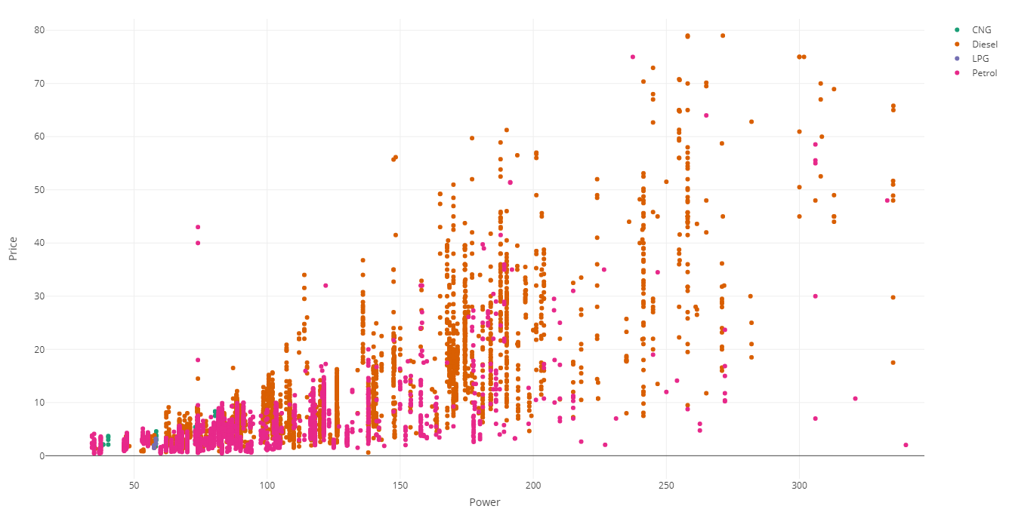
ScatterPlot of Price vs Power vs Fuel type

Slide 36
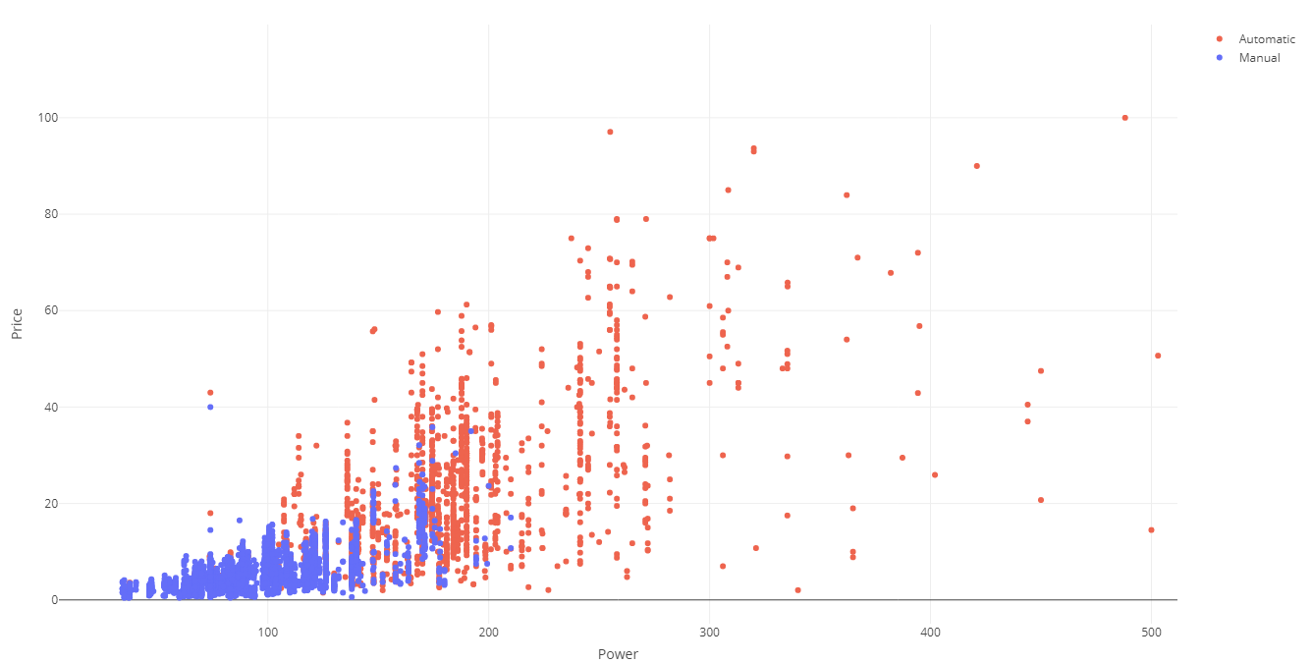
ScatterPlot of Price vs Power vs Transmission

Slide 37
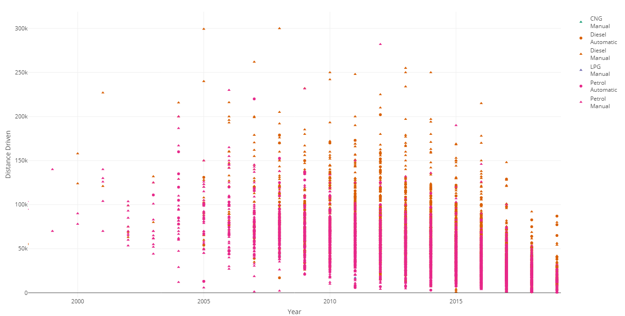
ScatterPlot of Distance vs Year vs Fuel type vs Transmission

Slide 38
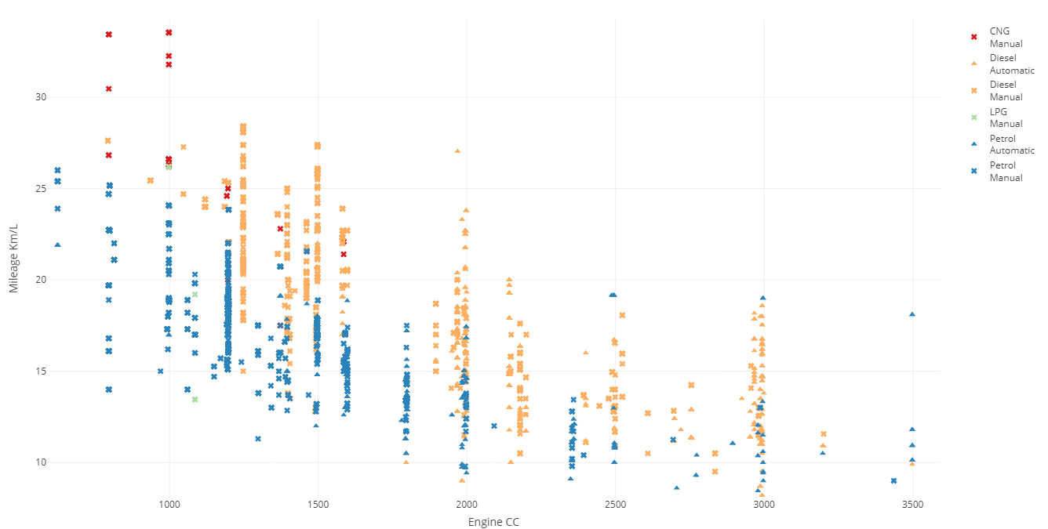
ScatterPlot of Mileage vs Engine vs Fuel type vs Transmission

Slide 39
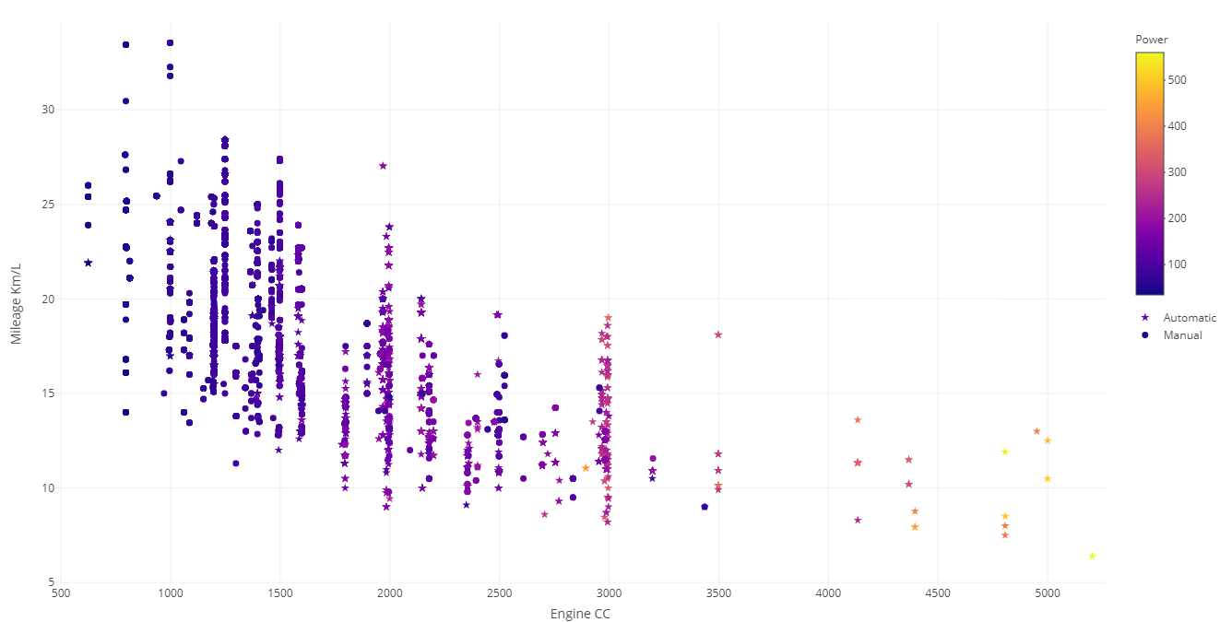
ScatterPlot of Mileage vs Engine vs Power vs Transmission

Slide 40
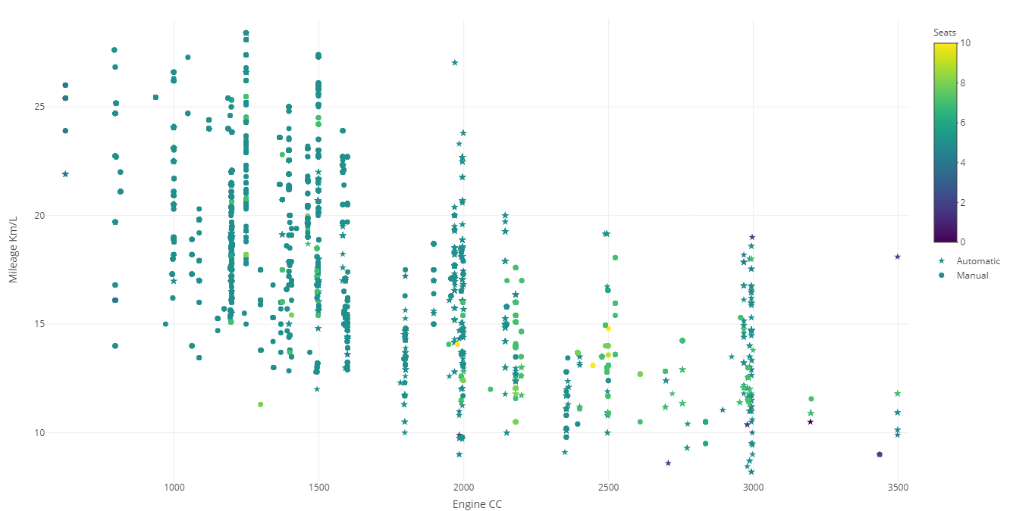
ScatterPlot of Mileage vs Engine vs Seats vs Transmission

Slide 41
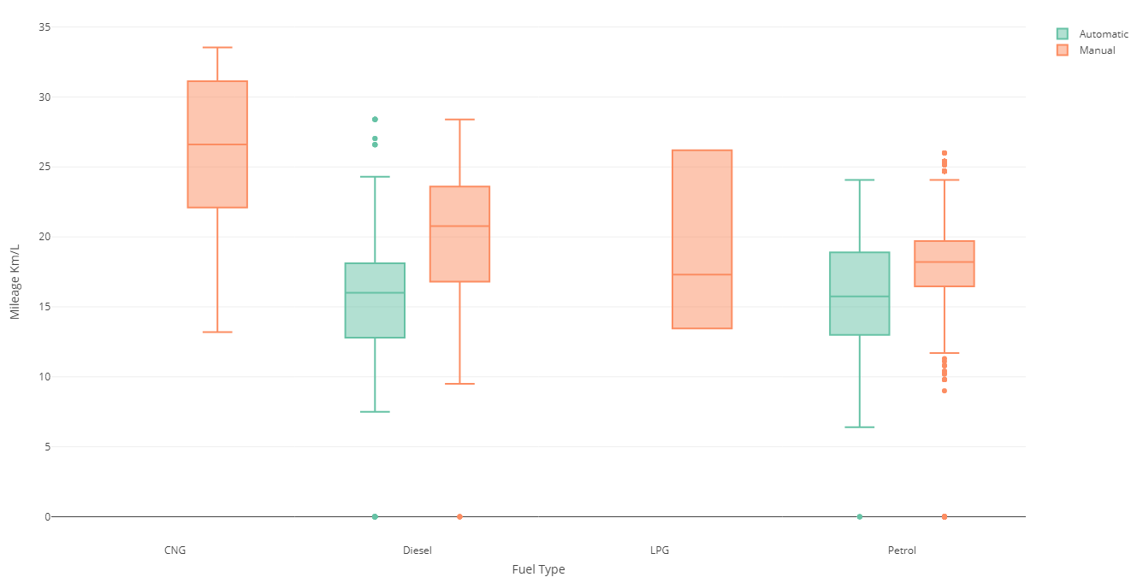
BoxPlot of Mileage vs Fuel type vs Transmission

Slide 42
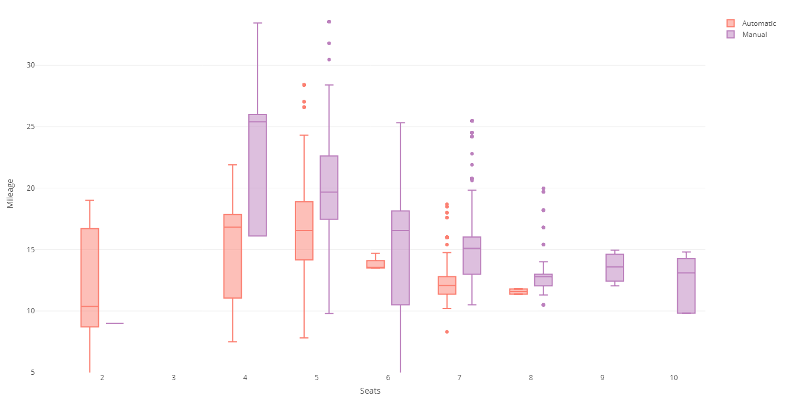
BoxPlot of Mileage vs Seats vs Transmission

Slide 43
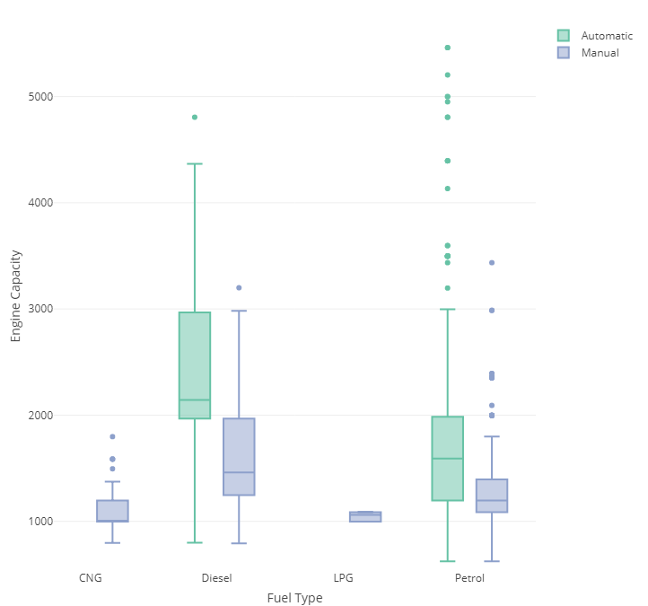
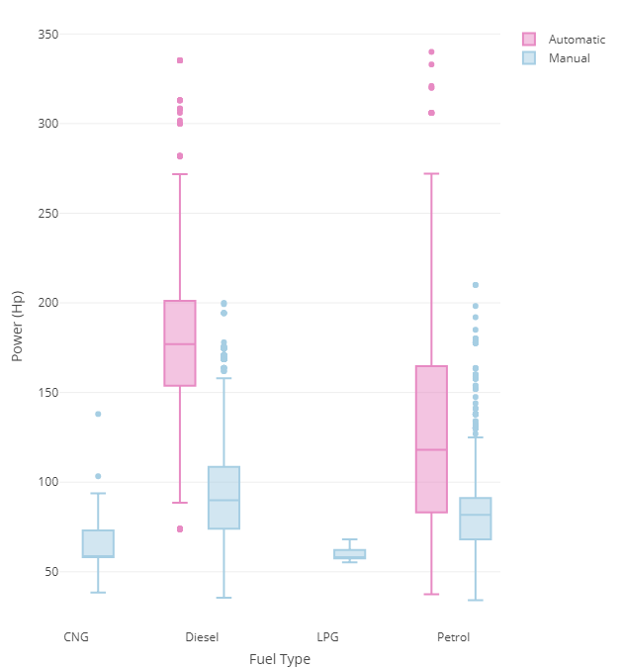
BoxPlot of Engine vs Power vs Fuel type vs Transmission

Slide 44
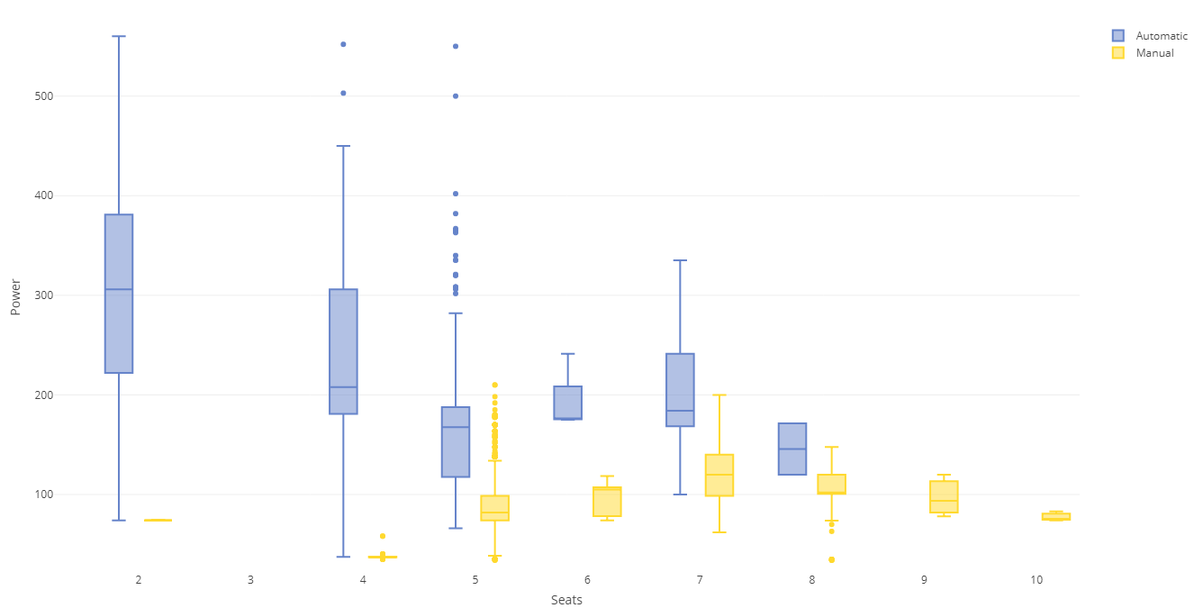
BoxPlot of Power vs Seats vs Transmission

Slide 45
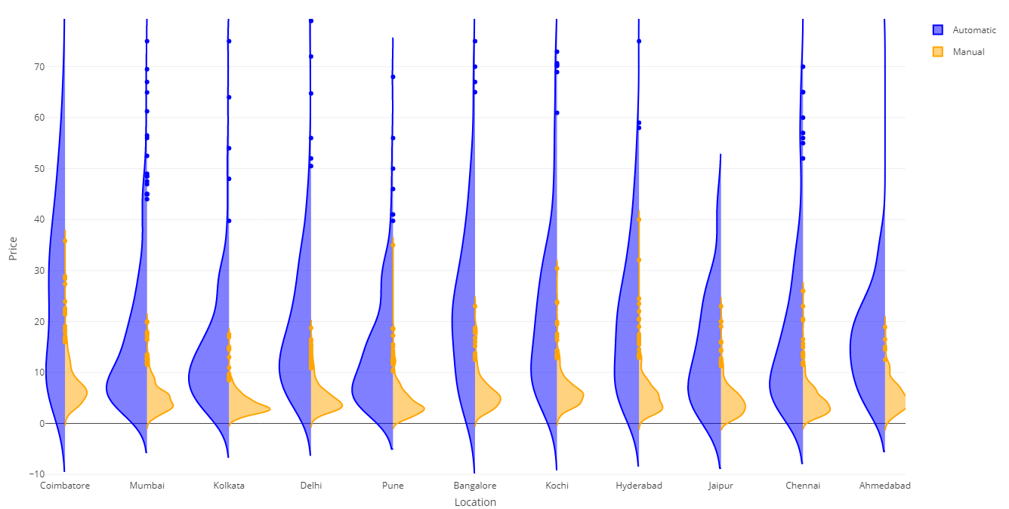
Split ViolinPlot of Price vs Location vs Transmission

Slide 46
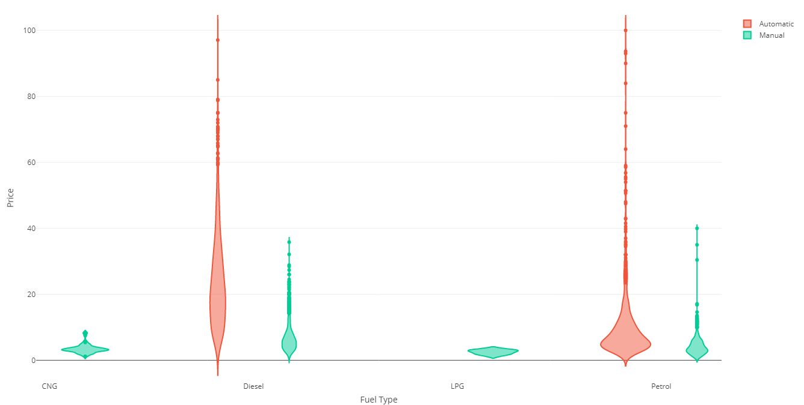
ViolinPlot of Price vs Fuel Type vs Transmission

Slide 47
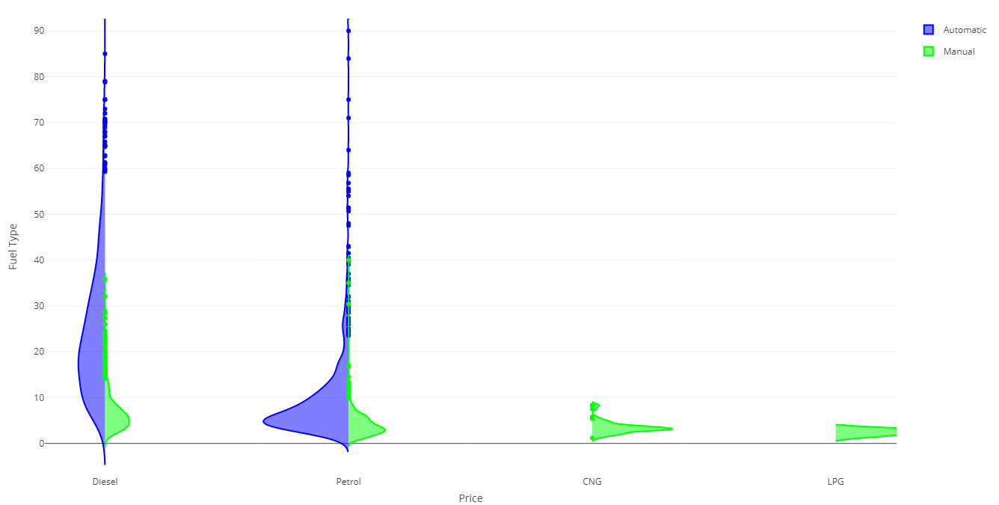
Split ViolinPlot of Price vs Fuel Type vs Transmission

Slide 48


Split ViolinPlot of Price vs Fuel Type vs Transmission

Slide 49

Data Analysis using Regression Model

Slide 50
ScatterPlot of Mileage vs Engine vs Power vs Transmission

